Slide 1

Department Of Electronics & Communication Engineering MANIT BHOPAL
Minor Project
By
Prachi Devikar (171114018)
Urvashi Tomar (171114022)
Ishika Singh (171114080)
Palak Agrawal (171114117)
Shreya Sood (171114150)
Under Supervision Of
Dr. Lalita Gupta
1

Slide 2
PROJECT TITLE
AMERICAN SIGN LANGUAGE RECOGNITION
2

Slide 3
OUTLINE
Introduction
Objective
Dataset Description
Core Modules
Block Diagram
Software Requirements
Convolutional Neural Network (CNN)
Future Scope and Advancements
Result and Conclusion
References
3

Slide 4
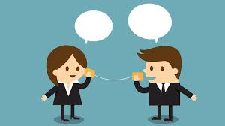
INTRODUCTION
Communication is very crucial to human beings, as it enables us to express ourselves. We communicate through speech, gestures, and body language.
4

Slide 5
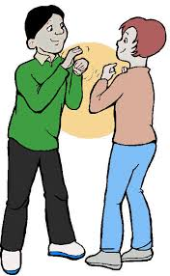
PROBLEM
5
In our society we have people with disabilities.
The technology is developing day by day but no significant development are undertaken for the betterment of deaf and dumb people.
Communication between deaf-mute and a normal person have always been a challenging task.
Sign language helps deaf and dumb people to communicate with other people.
But not all understand sign language.

Slide 6
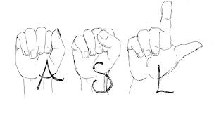
SOLUTION
6
Sign language recognition system is widely used technology for helping the deaf and dumb people.
Human hand has remained a popular choice to convey information in situations where other forms like speech cannot be used.
We aim for developing an american sign language recognition system for establishing communication between deaf-mute people.

Slide 7
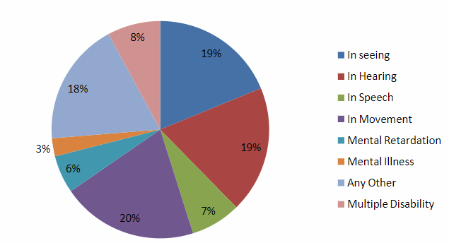
Disabled population by type of disability in India census 2011
7

Slide 8
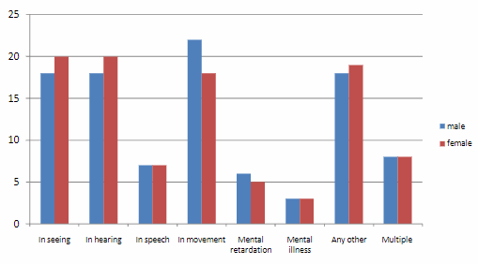
Distribution disabled person by sex and by type of disability (%) in India Census 2011
8

Slide 9
OBJECTIVE
Build a system that can correctly identify American Sign
Language signs that corresponds to the hand gesture.
9

Slide 10

DATASET DESCRIPTION
10

Slide 11
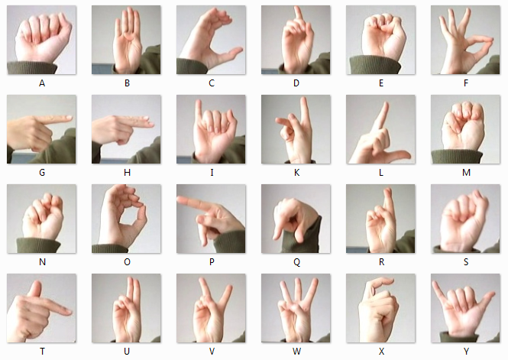
American Sign Language
Source: Kaggle.com
11

Slide 12
CORE MODULES

Slide 13
Data Pre-Processing
Feature Learning
Sign Language Scanning & Recognition
13

Slide 14
BLOCK DIAGRAM

Slide 15
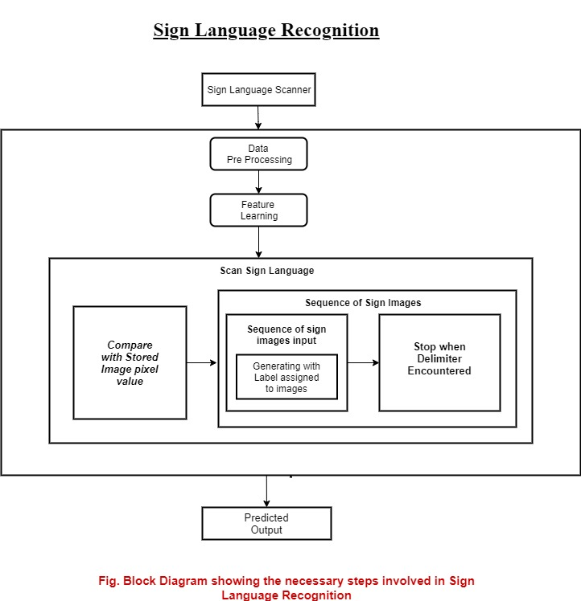
15

Slide 16

SOFTWARE REQUIREMENTS
16

Slide 17
Microsoft Windows XP or later
Python Interpreter(3.7.2)
Tensorflow Framework
Keras API
Python OpenCV2
PyQT5
17

Slide 18
Convolutional Neural Network

Slide 19
Layers in CNN
19
Convolutional layer
Relu layer
Pooling
Fully connected layer

Slide 20
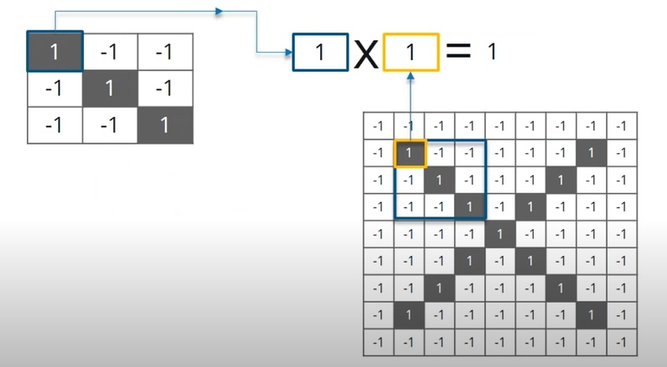
1. Convolutional Layer
20

Slide 21
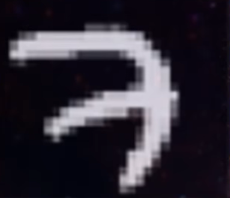

Slide 22
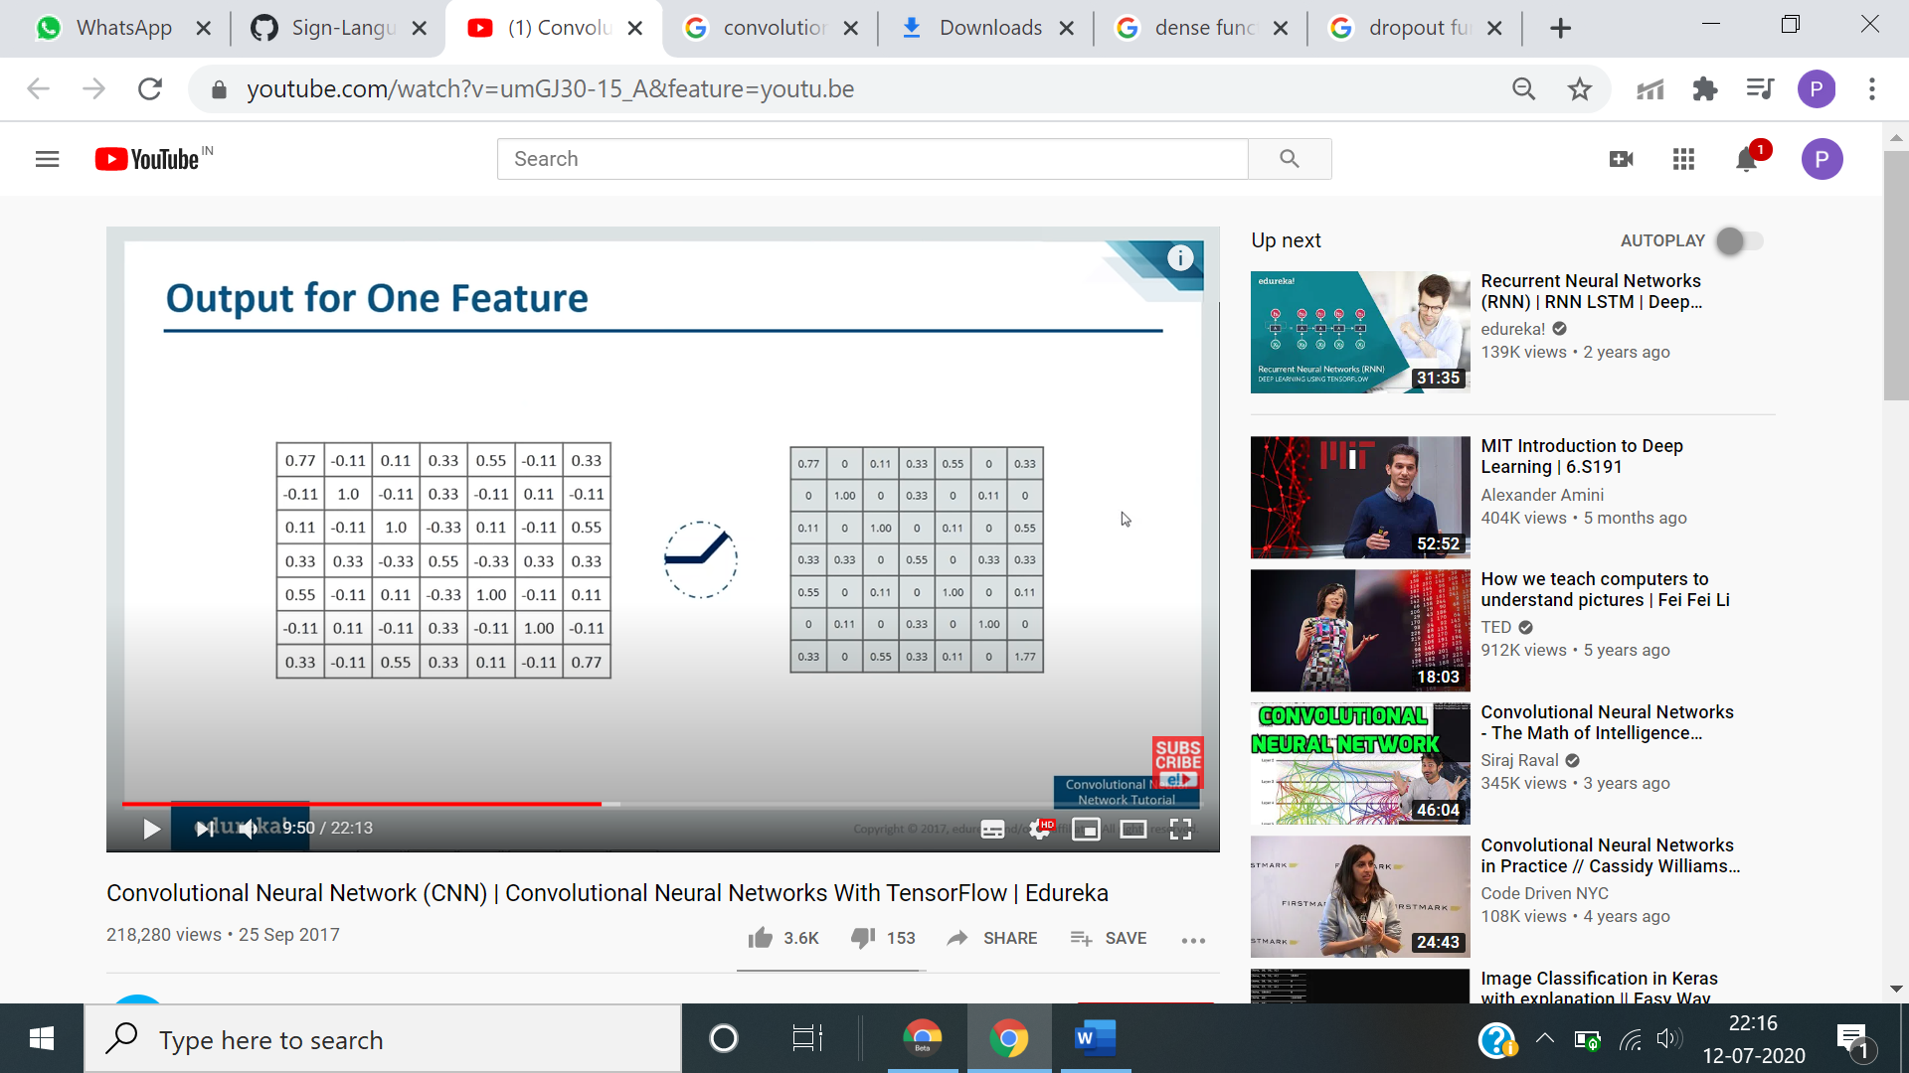
2. ReLU Layer
21

Slide 24
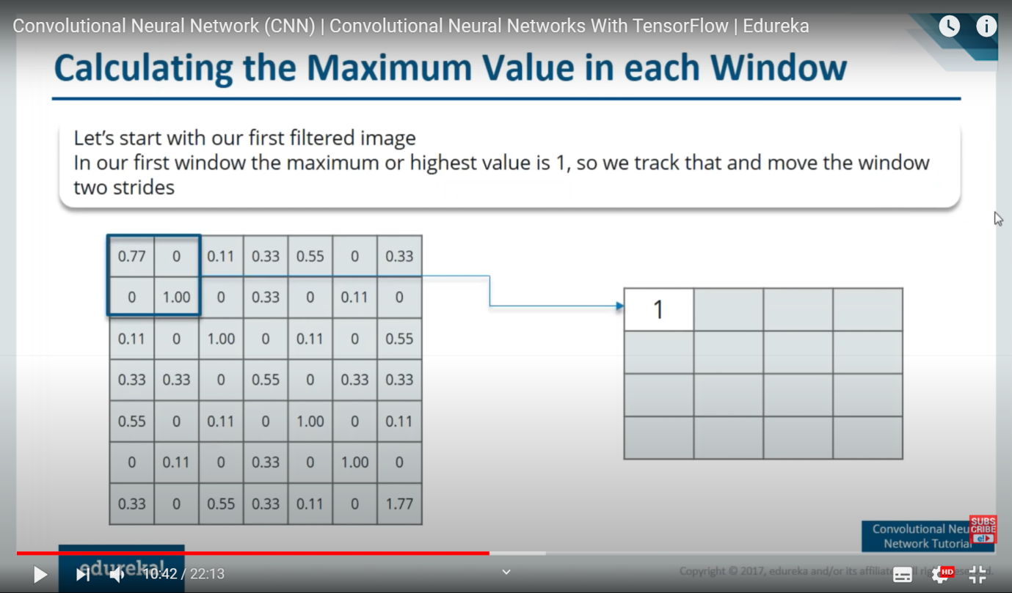
3. Pooling Layer
22

Slide 25
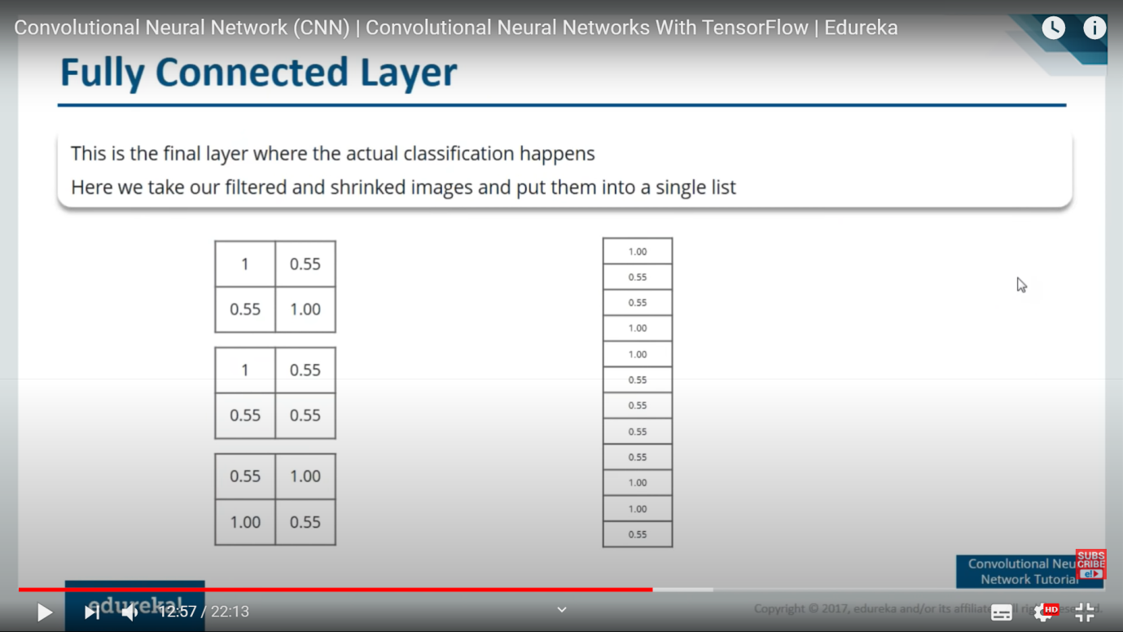
4. Fully Connected Layer
23

Slide 26
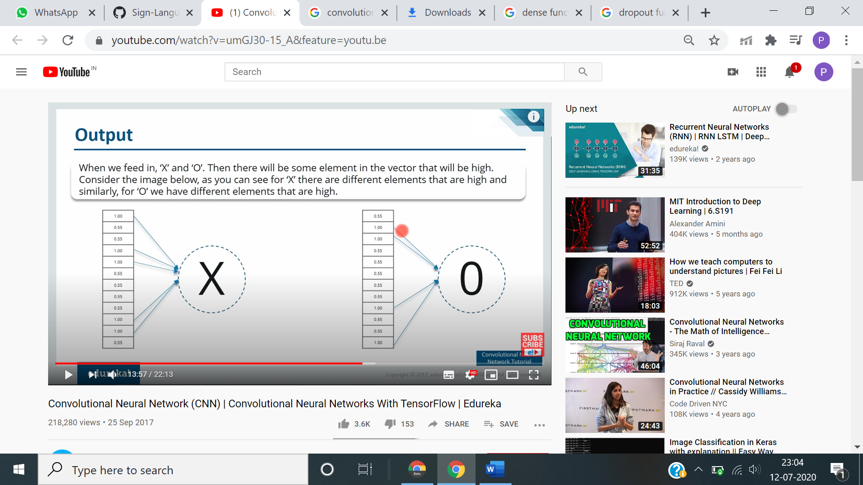
Detection
24

Slide 27
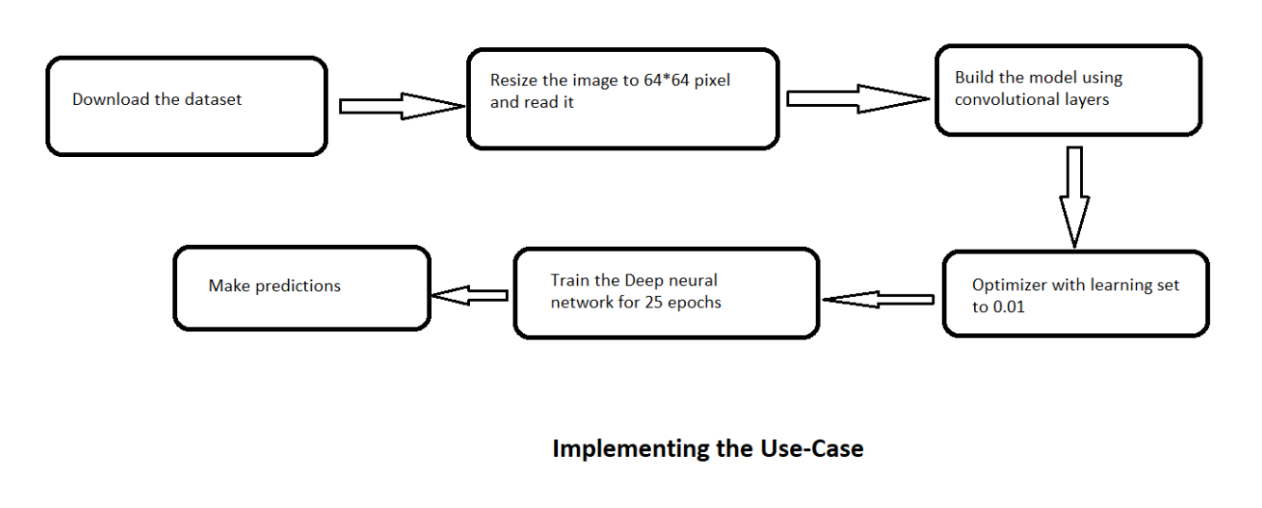

Slide 28
Future Scope and Advancements
❏ Integration with search engines and texting applications.
❏ Detection of motion video sequence and assigning it a meaningful sentence with TTS assistance.
❏ Provide assistance to the impaired in public places like banks, malls etc. and public transport as well.
25

Slide 29
Result & Conclusion
26
❏ Overshadowing some of the major problems faced by the person having speech disorders.
❏ A user need not be a literate person.
❏ They can quickly learn what alphabet is assigned to which gesture with this application.
❏ We believe that further variation in the ratio of training to test data could lead to a more accurate result.

Slide 30
References
1. NIDCD, “american sign language”, 2017 [Online]. Available: https://www.nidcd.nih.gov/health/american-sign-language, [Accessed April 06, 2019]
2. https://www.kaggle.com/datamunge/sign-language-mnist
3. Suharjito MT, “Sign Language Recognition Application Systems for Deaf-Mute People A Review Based on Input-Process-Output”, 2017 [Online]https://www.academia.edu/35314119/Sign_Language_Recognition_Application_Systems_for_Deaf-Mute_People_A_Review_Based_on_Input-Process-Output
27

Slide 31
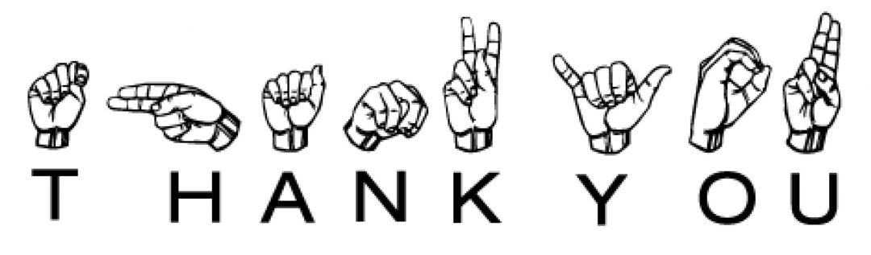
Thank You for your kind attention
28

